Slide 1
EuropEAN MIGRATION POLICIES

Slide 2
The Foundation: Building a Common Asylum System
The Treaty of Amsterdam (1999) marked a turning point by granting the European Union formal authority over migration and asylum matters, transferring key competencies from the national to the supranational level. This laid the institutional foundation for developing a more coordinated and harmonized approach among member states.
Building on this, the Tampere European Council (1999) set out an ambitious political agenda, proposing the creation of a Common European Asylum System (CEAS). It emphasized the need for fair and efficient asylum procedures, approximation of national legislations, and the establishment of common standards to ensure protection for those in need, while also managing migration flows more effectively.
Within this framework, the Dublin II Regulation introduced a clear mechanism for determining which member state is responsible for examining an asylum application. Its main objective was to prevent “asylum shopping” and multiple applications across different countries, by assigning responsibility primarily to the first EU country of entry.

Slide 3
Evolution and Reform: From CEAS to the Pact
The first phase of the Common European Asylum System (CEAS) was completed by 2005, introducing a set of minimum standards on asylum procedures, reception conditions, and qualification criteria across member states. However, significant disparities in implementation led to a second phase of reforms, finalized in 2013, which strengthened and harmonized these rules through updated directives and regulations aimed at ensuring more consistent protection standards throughout the EU.
As part of these efforts, the European Asylum Support Office (EASO) was established to enhance practical cooperation among member states. Its role includes providing technical and operational support, facilitating information exchange, and assisting countries facing particular pressure on their asylum systems.
The 2015 migrant crisis exposed structural weaknesses in the CEAS, particularly regarding burden-sharing and solidarity between member states. In response, the European Commission proposed a third phase of reforms, seeking to create a more resilient and equitable system, including changes to the Dublin framework and stronger mechanisms for responsibility-sharing across the EU.

Slide 4
The New Era: Pact on Migration and Asylum (2024-26)
A comprehensive approach was developed to strengthen and better integrate EU policies on migration, asylum, and border management, recognizing that these areas are deeply interconnected and require coordinated action at the European level. This approach seeks to balance effective control of external borders with the protection of fundamental rights and the need for international protection.
It aims to establish firm but fair rules for managing migration in the long term, ensuring both efficiency and solidarity among member states. At the same time, it allows for a degree of flexibility, acknowledging the different capacities and circumstances of individual countries while maintaining a common framework.

Slide 5
Four Pillars of the New Pact: Securing Borders and Fair Procedures
Secure External Borders: Robust screening, identification, security, and health checks for all illegal arrivals.
Eurodac Database: A fully-fledged asylum and migration database for clear identification.
Border Procedure & Returns: Mandatory border procedures for those unlikely to need protection, with efficient returns.
Crisis Protocols: Quick response mechanisms and funding for emergency situations.

Slide 6
Asylum and Migration Management: Responsibility and Solidarity
Asylum Migration Management Regulation (AMMR) ensures effective determination of responsible EU countries.
New solidarity mechanism: Mandatory contributions from member states (relocation, financial, or capacity building).
Fast-track procedures for asylum seekers from countries with low acceptance rates (under 20%).

Slide 7
Asylum and Migration Management: Responsibility and Solidarity
Asylum Migration Management Regulation (AMMR) ensures effective determination of responsible EU countries.
New solidarity mechanism: Mandatory contributions from member states (relocation, financial, or capacity building).
Fast-track procedures for asylum seekers from countries with low acceptance rates (under 20%).

Slide 8
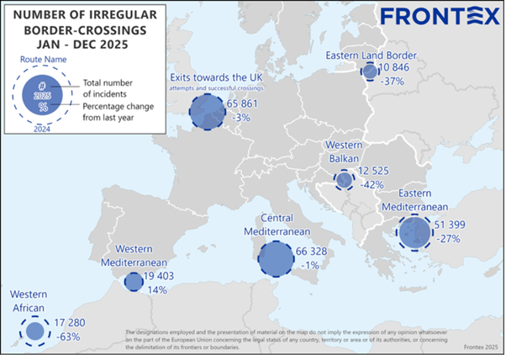
IRREGULAR BORDER CROSSINGS

Slide 9
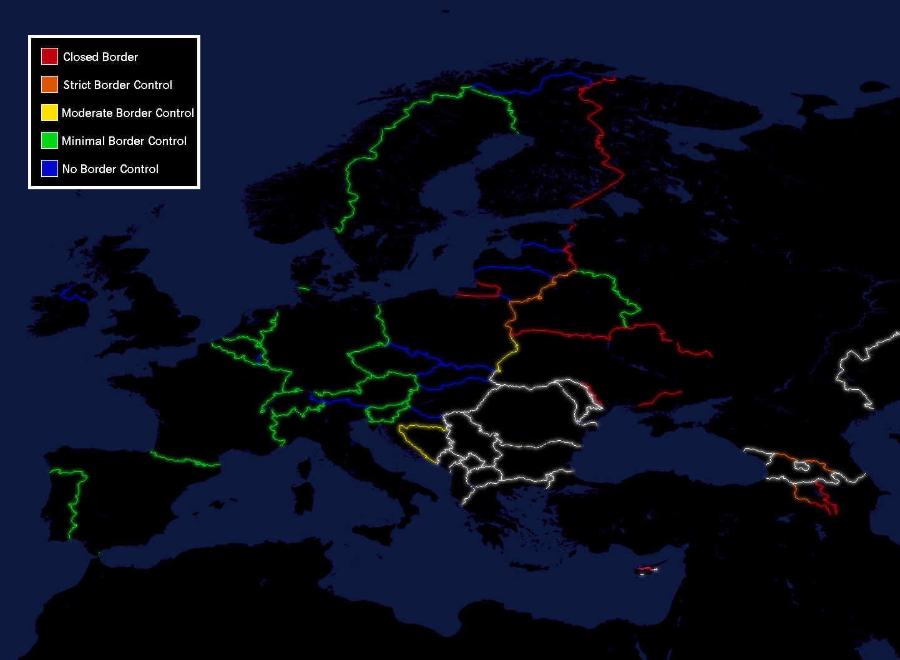
EUROPE BORDER STRATEGY

Slide 10
Key Priorities of the 2026 Strategy
Migration Diplomacy: Mutually beneficial partnerships, using incentives (visa, trade), and a whole-of-route approach.
Strong EU Borders: Roll-out of EES and ETIAS, enhanced Frontex role.
Fair & Adaptable System: Continued focus on implementing the Pact on Migration and Asylum.

Slide 11
The Five-Year Strategy (2026-2031): A Forward-Looking Approach
Presented January 29, 2026, by the European Commission.
Objective 1: Prevent illegal migration and break criminal smuggling networks.
Objective 2: Protect those fleeing war and persecution while preventing asylum system abuse.
Objective 3: Attract talent to boost EU economic competitiveness.

Slide 12
The Road Ahead: Challenges and Opportunities
Balancing security with humanitarian values remains one of the central challenges of European migration policy, requiring the EU to protect its external borders while upholding its commitments to human rights and international protection.
Ensuring effective solidarity among member states is equally crucial, as uneven responsibility-sharing has historically created tensions within the Union. A more cohesive system depends on mutual trust, cooperation, and fair distribution of obligations.
At the same time, EU policies must continuously adapt to evolving global migration patterns and shifting geopolitical contexts, including conflicts, climate change, and economic disparities that influence migration flows.
Ultimately, the future of migration management in a dynamic Europe will depend on the EU’s ability to remain flexible, resilient, and united in addressing both immediate pressures and long-term structural challenges.

Slide 13
Criticisms of the EU 2026 Migration Strategy
Security-focused approach: Prioritises border control and returns over humanitarian protection
Weakened asylum safeguards: Faster procedures may reduce full individual assessment of claims
Externalisation concerns: Cooperation with third countries raises human rights and legal risks
Human rights at risk: Concerns about detention, pushbacks, and limited access to asylum procedures
Contested solidarity system: Debate over fairness of mandatory contributions vs. national sovereignty
Uneven burden-sharing: Frontline states remain under disproportionate pressure
Limited effectiveness: Risk of shifting migration routes rather than reducing flows overall

